Slide 1
Introduction to OpenSearch and Amazon OpenSearch Service
Izek Chen
Cloud Support Engineer
2022.05.28

Slide 2

OpenSearch is a community-driven, open source search and analytics suite derived from Apache 2.0 licensed Elasticsearch 7.10.2
The OpenSearch project consists of a distributed search engine powered by Apache Lucene, OpenSearch, and a data visualization and user interface, OpenSearch Dashboards
OpenSearch also includes all of the advanced functionality ported over from Open Distro for Elasticsearch
Notes:
Purpose of the slide: Give a brief background on OpenSearch, the open-source engine that powers Amazon OpenSearch Service.
In January 21, 2021, Elastic NV announced that they would change their software licensing strategy and not release new versions of Elasticsearch and Kibana under the permissive Apache License, Version 2.0 (ALv2) license. Instead, new versions of the software will be offered under the Elastic license, with source code available under the Elastic License or SSPL. These are not open source and do not offer users the freedoms of open source. To ensure that the open source community and our customers continue to have a secure, high-quality, fully open source search and analytics suite, AWS introduced OpenSearch; a community-driven, ALv2 licensed fork of open source Elasticsearch and Kibana.
The ALv2 license gives the open source community and our customers the freedom to use, modify, extend, embed, monetize, resell, and offer OpenSearch as part of their products and services. The announcement of OpenSearch has garnered positive support from the community. Numerous organizations such as SAP, Capital One, Dow Jones, Logz.io, and Red Hat, and individual contributors have expressed interest in joining the project and helping develop OpenSearch.

Slide 3
Search workloads…
Analytics workloads…
Load your data in and search it Structured and unstructured
Language-aware full-text processing, rich queries, adjustable ranking
Supports high volume ingest – customers at 100TB/day+
Near real-time availability of log data (seconds)
Visualizations, dashboards, and alerting for app/infra/security monitoring

Slide 4
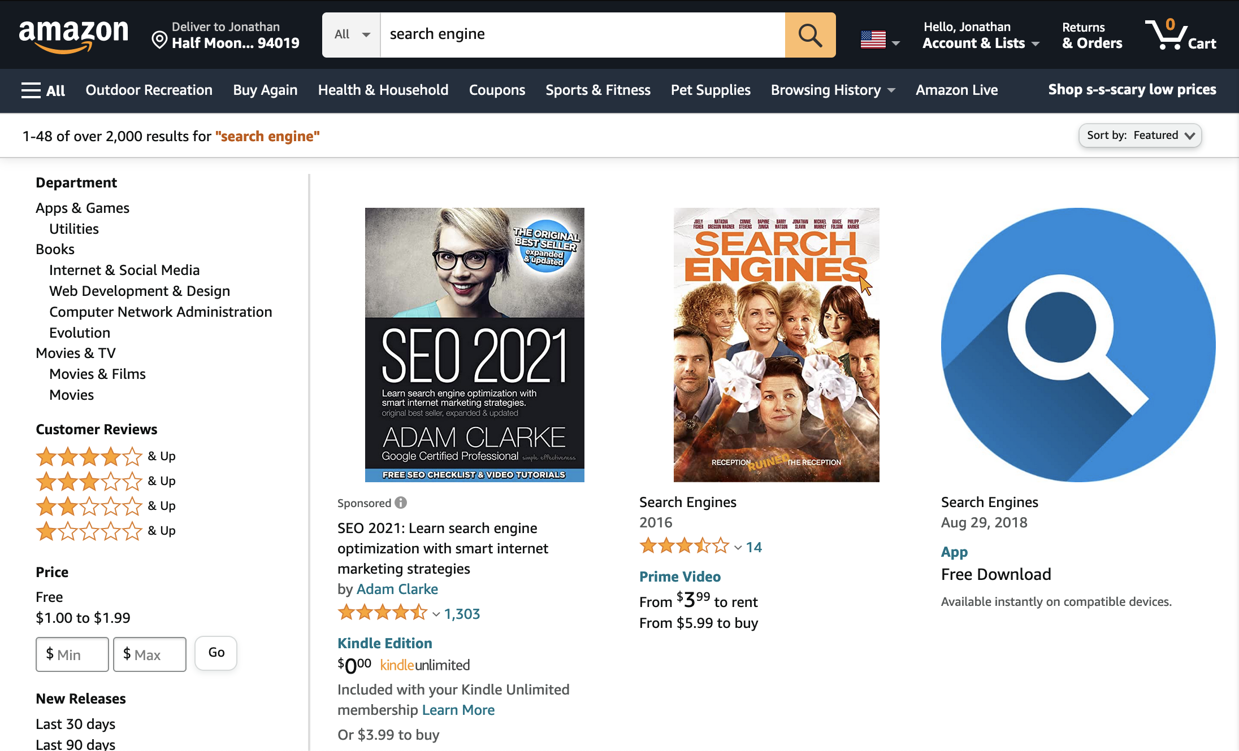
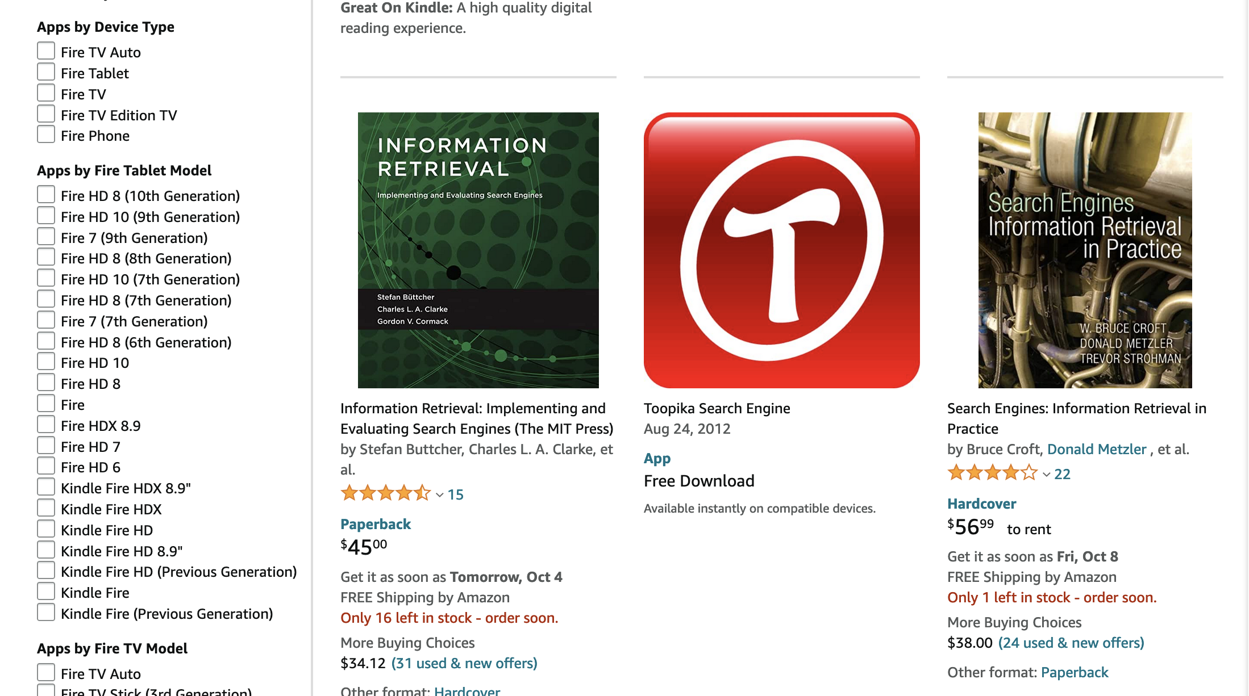
Searching
Search engines match terms to objects in a catalog
Match free text or structured data
Relevance determines sort order
Facets enable users to drill in to the search results to narrow by attribute value

Slide 5
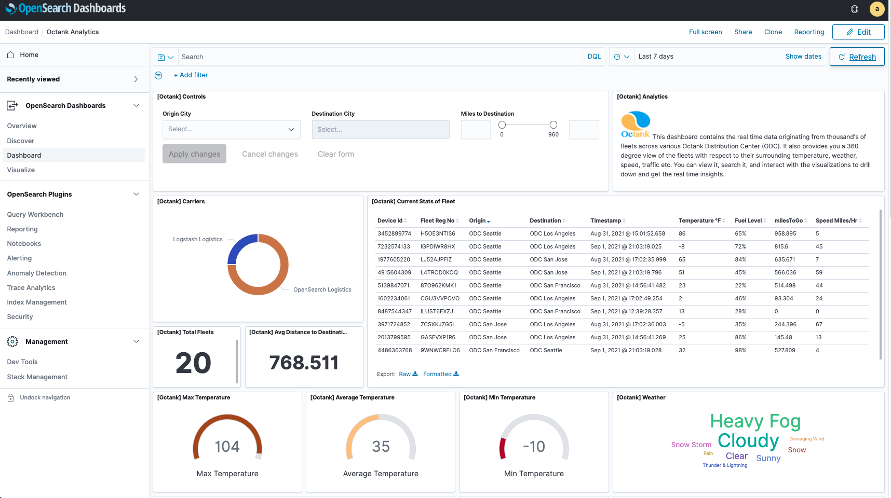
Analyzing streaming data (logs)
Notes:
Purpose of the slide: A closer look of a sample view of OpenSearch Dashboards. Give the customer a sense of this popular interface for the service.

Slide 6
How search engines work - interaction
1
2
3
Send data as JSON via REST APIs
Data is indexed— all fields searchable, including nested JSON
REST APIs, for fielded matching, Boolean expressions, sorting, and analysis
2
1
3
Server, application, network, AWS, and other logs
Application data
OpenSearch cluster
Application users, analysts, DevOps, security
Notes:
Purpose of the slide: The diagram explains how OpenSearch works at a high level. The data gets sent in JSON format, it’s then indexed, and finally becomes available for the end user to search and analyze against.

Slide 7
{
"id" : "tt0371746",
"title" : "Iron Man",
"release_date" : "2008-04-14T00:00:00Z",
"actors" : [
"Robert Downey Jr.",
"Gwyneth Paltrow",
"Terrence Howard"
],
"directors" : [
"Jon Favreau"
],
"rating" : 7.9,
"rank" : 171,
"running_time_secs" : 7560,
"genres" : [
"Action",
"Adventure",
"Sci-Fi"
],
"plot" : "When wealthy industrialist Tony Stark is forced to build an armored suit after a life-threatening incident, he ultimately decides to use its technology to fight against evil.",
}
OpenSearch works with structured JSON containing fields and values

Slide 8
You use the indexing APIs to send data to OpenSearch*
POST endpoint/index/type/id
{
Document
}
POST endpoint/index/_bulk
{ Command }
{ Document }
{ Command }
{ Document }
* Your ingestion tools might automate this
Notes:
This is the low level interface for sending documents to Amazon ES. You’ll likely never call these directly. Instead, the tool that you’re using for ingest will call them on your behalf.

Slide 9
How search engines work - indexing
Source text
Information Retrieval: Implementing and Evaluating Search Engines
Posting list
Information Retrieval: Implementing and Evaluating Search Engines
Analysis
Terms
Index

Slide 10
How search engines work – query processing
Query text
Search Engines
Posting lists
Matches
Results
Search
Engines
Analysis
Terms
Index
Merge
Score and Sort

Slide 11
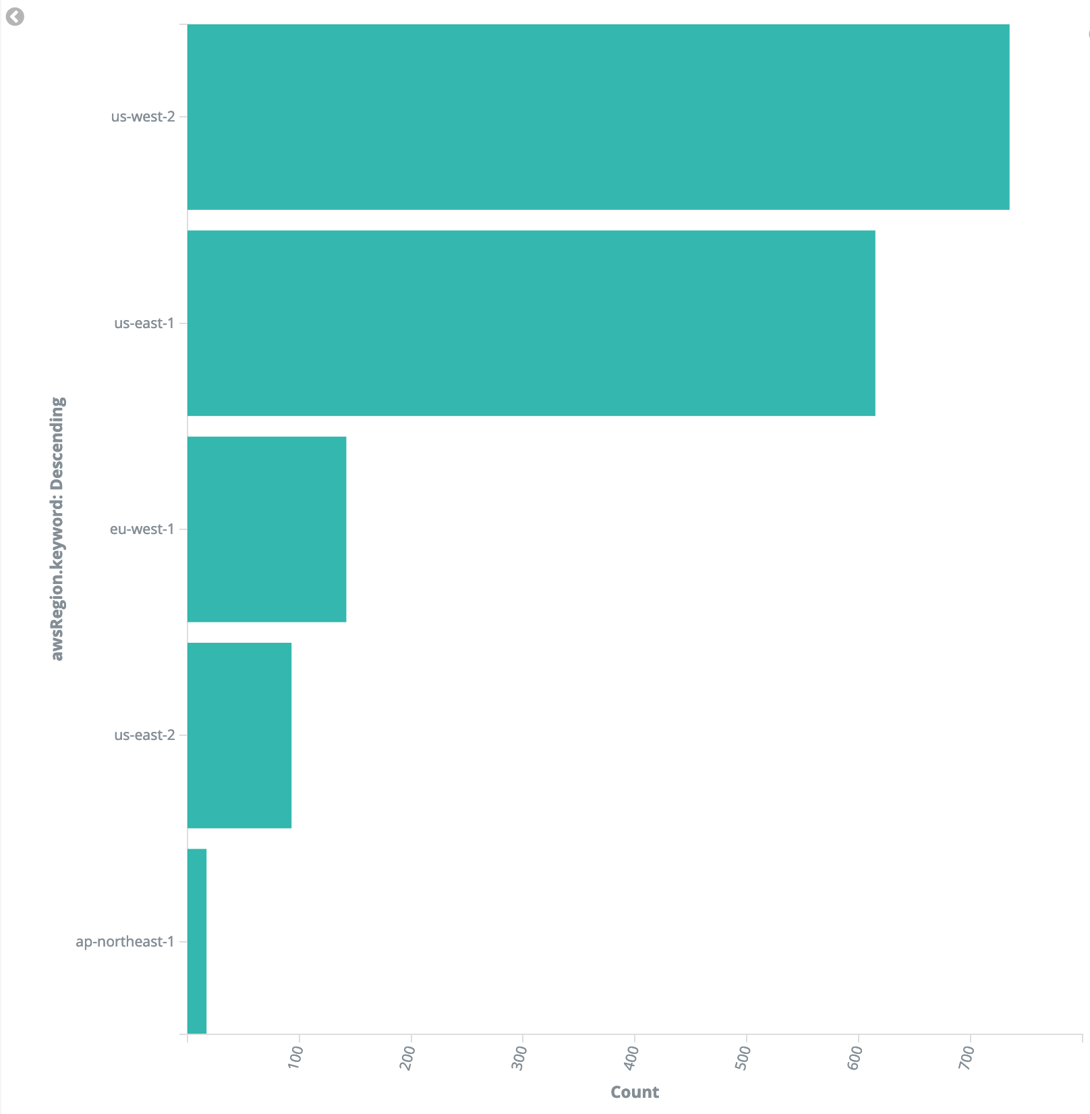
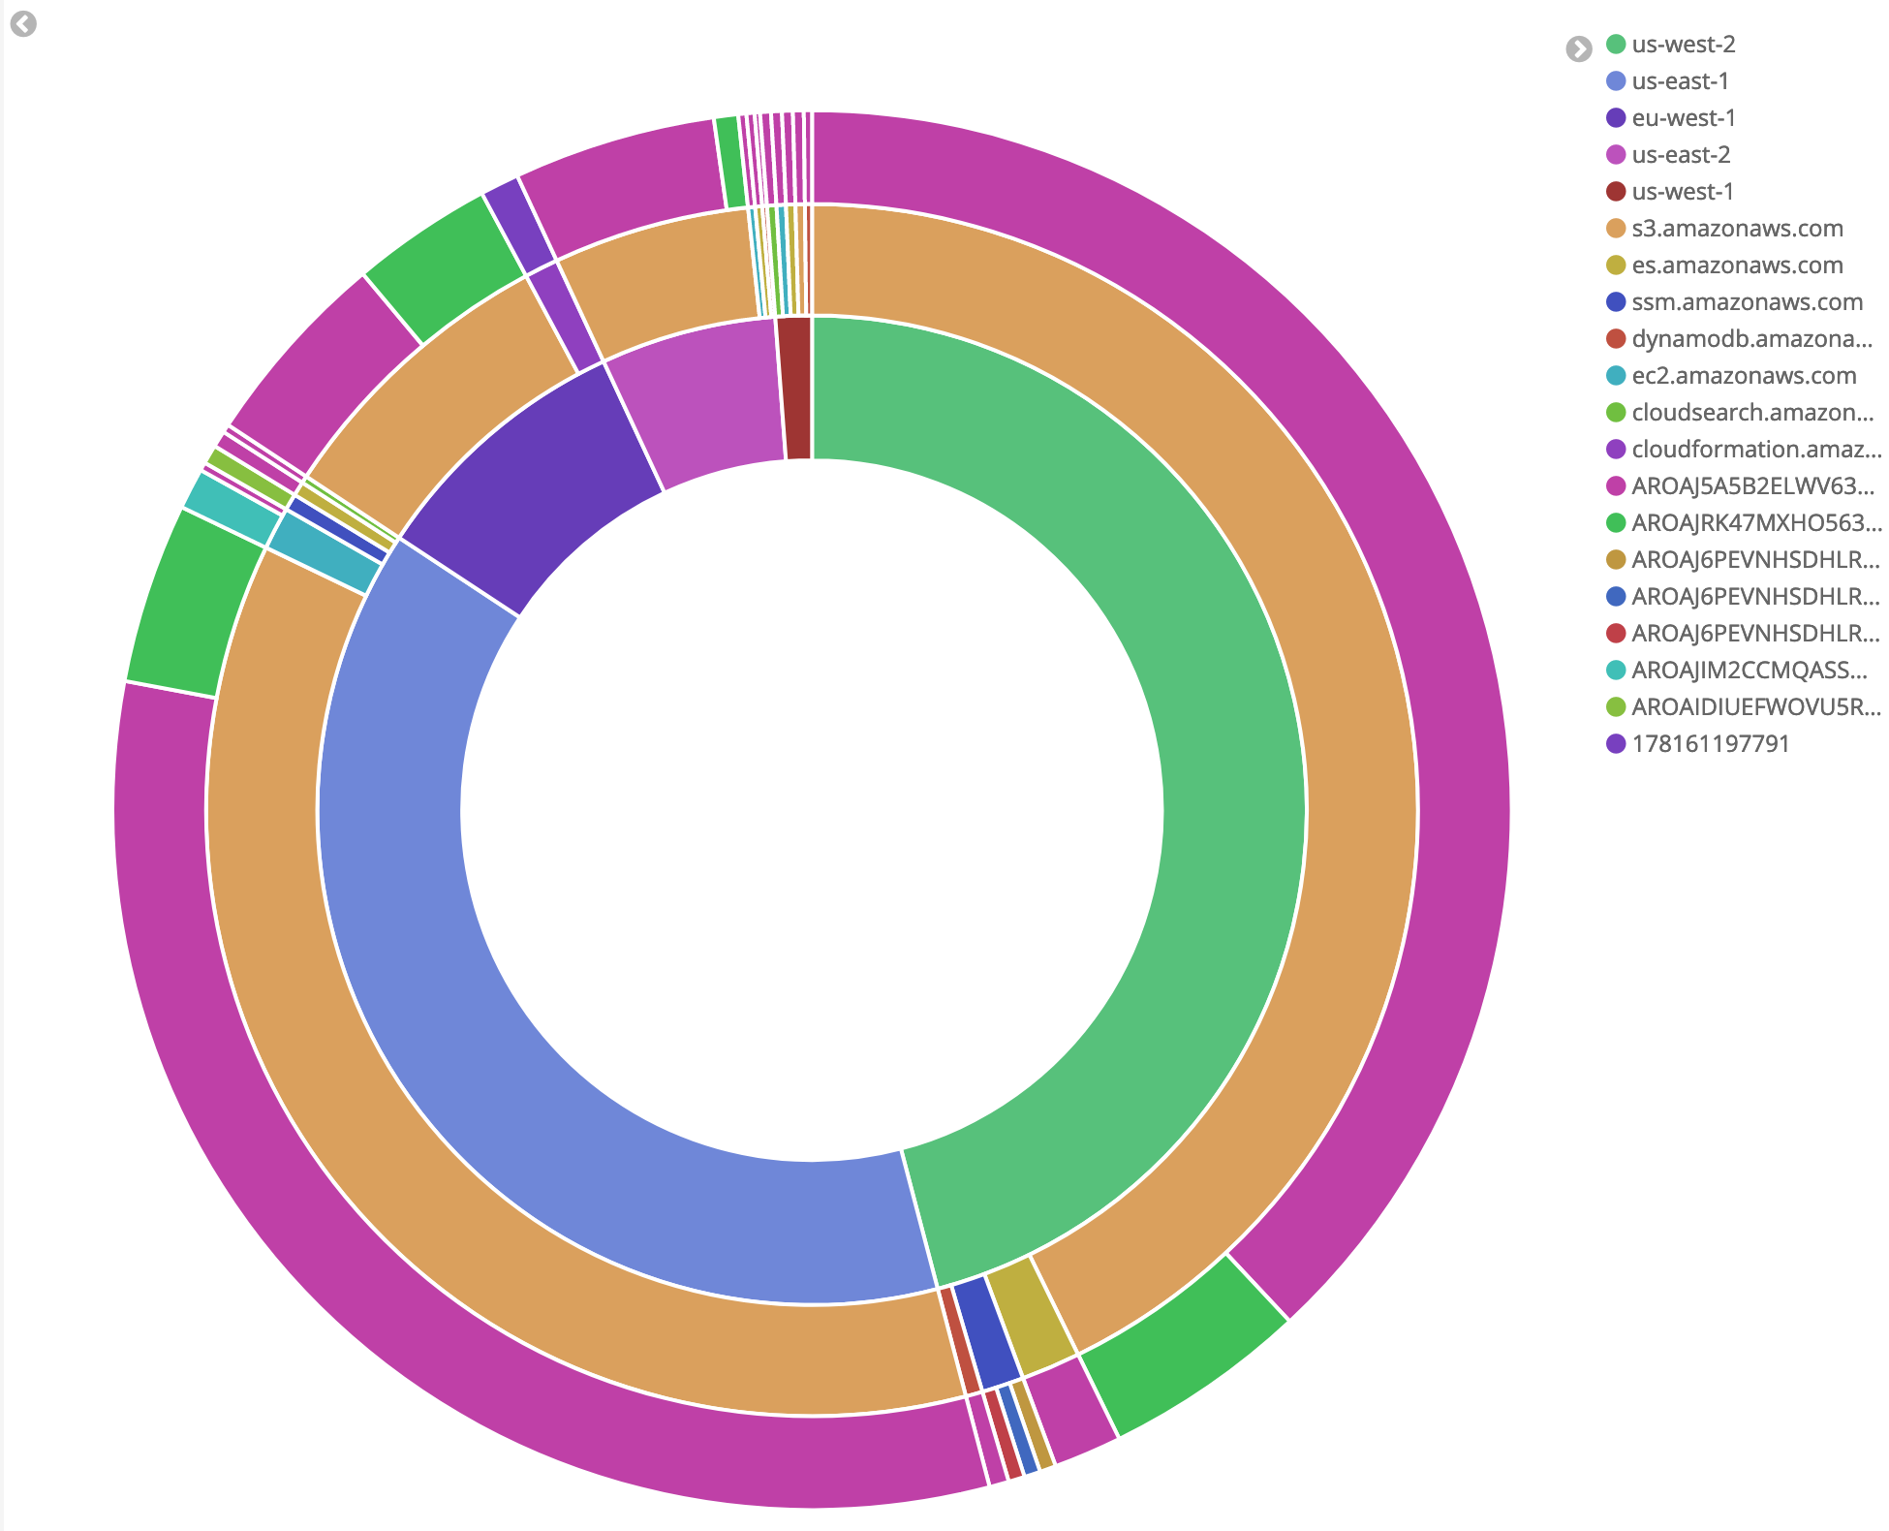
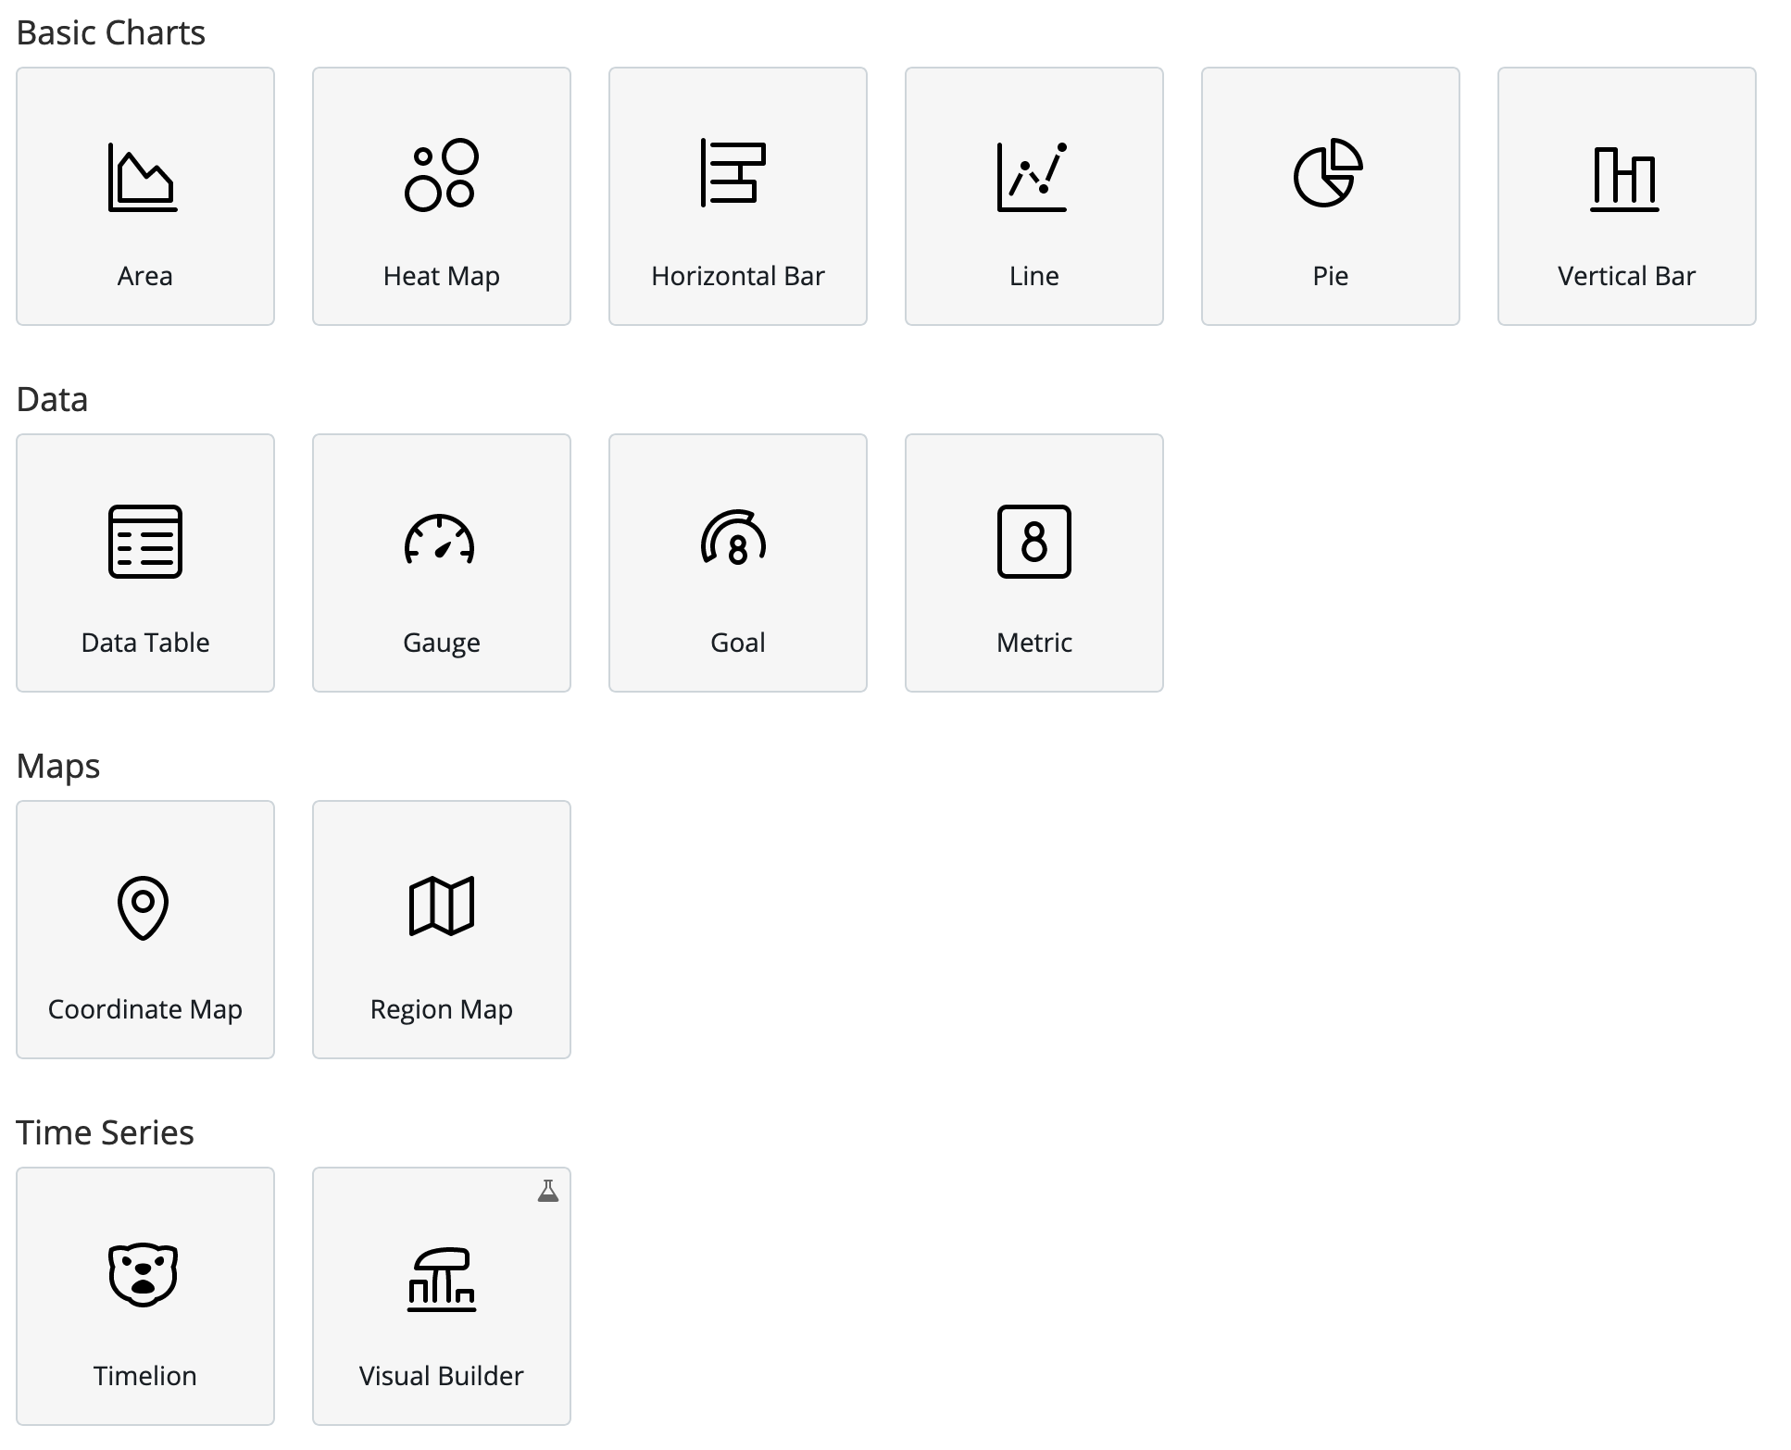
How search engines work - analytics
You can aggregate on terms, dates, ranges, histograms, and more. Pipeline aggregations allow you to chain aggregations.
Nesting aggregations allows you to slice your data along multiple dimensions – response codes by request URL, e.g.
OpenSearch Dashboards offers rich visualizations from charts to gauges to maps and time series

Slide 12
Filtering – host = “199.120*” or “burger*”
Host | Timestamp | Verb | Request | Http | Status | Size
199.72.81.55 | [01/Jul/1995:00:00:01 | GET | /history/apollo/ | HTTP/1.0 | 200 | 6245
unicomp6.unicomp.net | [01/Jul/1995:00:00:06 | GET | /shuttle/countdown/ | HTTP/1.0 | 200 | 3985
199.120.110.21 | [01/Jul/1995:00:00:09 | GET | /shuttle/missions/sts-73/mission-sts-73.html | HTTP/1.0 | 200 | 4085
burger.letters.com | [01/Jul/1995:00:00:11 | GET | /shuttle/countdown/liftoff.html | HTTP/1.0 | 304 | 0
199.120.110.21 | [01/Jul/1995:00:00:11 | GET | /shuttle/missions/sts-73/sts-73-patch-small.gif | HTTP/1.0 | 200 | 4179
burger.letters.com | [01/Jul/1995:00:00:12 | GET | /images/NASA-logosmall.gif | HTTP/1.0 | 304 | 0
burger.letters.com | [01/Jul/1995:00:00:12 | GET | /shuttle/countdown/video/livevideo.gif | HTTP/1.0 | 200 | 0
205.212.115.106 | [01/Jul/1995:00:00:12 | GET | /shuttle/countdown/countdown.html | HTTP/1.0 | 200 | 3985
d104.aa.net | [01/Jul/1995:00:00:13 | GET | /shuttle/countdown/ | HTTP/1.0 | 200 | 3985
129.94.144.152 | [01/Jul/1995:00:00:13 | GET | / | HTTP/1.0 | 200 | 7074

Slide 13
Aggregation – status histogram
Host | Timestamp | Verb | Request | Http | Status | Size
199.72.81.55 | [01/Jul/1995:00:00:01 | GET | /history/apollo/ | HTTP/1.0 | 200 | 6245
unicomp6.unicomp.net | [01/Jul/1995:00:00:06 | GET | /shuttle/countdown/ | HTTP/1.0 | 200 | 3985
199.120.110.21 | [01/Jul/1995:00:00:09 | GET | /shuttle/missions/sts-73/mission-sts-73.html | HTTP/1.0 | 200 | 4085
burger.letters.com | [01/Jul/1995:00:00:11 | GET | /shuttle/countdown/liftoff.html | HTTP/1.0 | 304 | 0
199.120.110.21 | [01/Jul/1995:00:00:11 | GET | /shuttle/missions/sts-73/sts-73-patch-small.gif | HTTP/1.0 | 200 | 4179
burger.letters.com | [01/Jul/1995:00:00:12 | GET | /images/NASA-logosmall.gif | HTTP/1.0 | 304 | 0
burger.letters.com | [01/Jul/1995:00:00:12 | GET | /shuttle/countdown/video/livevideo.gif | HTTP/1.0 | 200 | 0
205.212.115.106 | [01/Jul/1995:00:00:12 | GET | /shuttle/countdown/countdown.html | HTTP/1.0 | 200 | 3985
d104.aa.net | [01/Jul/1995:00:00:13 | GET | /shuttle/countdown/ | HTTP/1.0 | 200 | 3985
129.94.144.152 | [01/Jul/1995:00:00:13 | GET | / | HTTP/1.0 | 200 | 7074

Slide 14
Aggregation – sum of bytes
Host | Timestamp | Verb | Request | Http | Status | Size
199.72.81.55 | [01/Jul/1995:00:00:01 | GET | /history/apollo/ | HTTP/1.0 | 200 | 6245
unicomp6.unicomp.net | [01/Jul/1995:00:00:06 | GET | /shuttle/countdown/ | HTTP/1.0 | 200 | 3985
199.120.110.21 | [01/Jul/1995:00:00:09 | GET | /shuttle/missions/sts-73/mission-sts-73.html | HTTP/1.0 | 200 | 4085
burger.letters.com | [01/Jul/1995:00:00:11 | GET | /shuttle/countdown/liftoff.html | HTTP/1.0 | 304 | 0
199.120.110.21 | [01/Jul/1995:00:00:11 | GET | /shuttle/missions/sts-73/sts-73-patch-small.gif | HTTP/1.0 | 200 | 4179
burger.letters.com | [01/Jul/1995:00:00:12 | GET | /images/NASA-logosmall.gif | HTTP/1.0 | 304 | 0
burger.letters.com | [01/Jul/1995:00:00:12 | GET | /shuttle/countdown/video/livevideo.gif | HTTP/1.0 | 200 | 0
205.212.115.106 | [01/Jul/1995:00:00:12 | GET | /shuttle/countdown/countdown.html | HTTP/1.0 | 200 | 3985
d104.aa.net | [01/Jul/1995:00:00:13 | GET | /shuttle/countdown/ | HTTP/1.0 | 200 | 3985
129.94.144.152 | [01/Jul/1995:00:00:13 | GET | / | HTTP/1.0 | 200 | 7074

Slide 15
Aggregation – bucketing terms
Host | Timestamp | Verb | Request | Http | Status | Size
199.72.81.55 | [01/Jul/1995:00:00:01 | GET | /history/apollo/ | HTTP/1.0 | 200 | 6245
unicomp6.unicomp.net | [01/Jul/1995:00:00:06 | GET | /shuttle/countdown/ | HTTP/1.0 | 200 | 3985
199.120.110.21 | [01/Jul/1995:00:00:09 | GET | /shuttle/missions/sts-73/mission-sts-73.html | HTTP/1.0 | 200 | 4085
burger.letters.com | [01/Jul/1995:00:00:11 | GET | /shuttle/countdown/liftoff.html | HTTP/1.0 | 304 | 0
199.120.110.21 | [01/Jul/1995:00:00:11 | GET | /shuttle/missions/sts-73/sts-73-patch-small.gif | HTTP/1.0 | 200 | 4179
burger.letters.com | [01/Jul/1995:00:00:12 | GET | /images/NASA-logosmall.gif | HTTP/1.0 | 304 | 0
burger.letters.com | [01/Jul/1995:00:00:12 | GET | /shuttle/countdown/video/livevideo.gif | HTTP/1.0 | 200 | 0
205.212.115.106 | [01/Jul/1995:00:00:12 | GET | /shuttle/countdown/countdown.html | HTTP/1.0 | 200 | 3985
d104.aa.net | [01/Jul/1995:00:00:13 | GET | /shuttle/countdown/ | HTTP/1.0 | 200 | 3985
129.94.144.152 | [01/Jul/1995:00:00:13 | GET | / | HTTP/1.0 | 200 | 7074

Slide 16












Amazon OpenSearch Service log ingestion flow
Producers
Collectors
Aggregators
Application/Infra Logs
Amazon Kinesis Data Firehose
Dashboards
Amazon Kinesis Agent
Security Logs
CloudWatch
Agent
Kibana 1.5 to 7.10
Amazon Managed Streaming for Kafka
AWS Service Logs
Amazon OpenSearch Service
Beats
Amazon Simple
Storage Service
OpenSearch Dashboards
Application Trace Data
fluentbit
Application/ Infrastructure metrics
fluentd
Logstash
Notes:
Purpose of the slide: Showcase common service patterns.

Slide 17









Amazon OpenSearch Service log ingestion flow
Primary storage
Forwarders
Application
Amazon Simple
Storage Service
Customer Application
Amazon Elastic Container Service
AWS Lambda
Amazon Relational Database Service
Amazon Elastic Kubernetes Service
Amazon OpenSearch Service
AWS Database Migration Service
Amazon DynamoDB
Amazon Elastic Compute Cloud
Amazon Neptune
Amazon API Gateway

Slide 18



Data lifecycle in Amazon OpenSearch Service
2
Hot tier Indexing and fast access
1
Index
Index
Index
Send data to Amazon OpenSearch and use Index State Management (ISM) to automate index migrations or deletions
Data is indexed and stored in the hot tier
Migrate the index to UltraWarm and Cold Storage for long-term, low cost storage
Delete the index at end-of-life
Index
1
2
3
UltraWarm and Cold Storage
Low cost, long term retention
3
4
4
Notes:
Purpose of the slide: Walk through the data lifecycle in Amazon OpenSearch Service and how Index State Management automates the tasks.
Index State Management (ISM) makes it easy for customers to manage recurring index management activities and saves time. In the past you had to use additional tools to manage the data lifecycle inside OpenSearch. For example, customers often setup daily indexes for their operational logs, roll them over nightly, and after 30 days delete the oldest index. With Index State Management, you can now create a policy that will automate these operations based on index age, size, and other conditions, all from within your Amazon OpenSearch Service domain.
Launch announcement:
https://aws.amazon.com/about-aws/whats-new/2020/03/automate-index-management-with-amazon-elasticsearch-service/

Slide 19
Amazon OpenSearch Service

Slide 20
Amazon OpenSearch Service
Amazon OpenSearch Service makes it easy for you to perform interactive log analytics, real-time application monitoring, website search, and more.
OpenSearch is an open source, distributed search and analytics suite derived from Elasticsearch. Amazon OpenSearch Service offers the latest versions of OpenSearch, support for 22 versions of Elasticsearch (1.5 to 7.10 versions, then OS v1.0 to v1.2), and visualization capabilities powered by OpenSearch Dashboards and Kibana (ES 1.5 to OS v1.2 versions).
Notes:
Purpose of the slide: Introduce Amazon OpenSearch Service, a fully managed service that helps customers address the needs you just talked through– cost effectively, securely, and at scale.

Slide 21
Self-managed vs. Amazon OpenSearch Service
Self Managed
Managed Service
On-Premises
Amazon EC2
Amazon OpenSearch Service
App Dev/ Optimization
App Dev/ Optimization
App Dev/ Optimization
Hot/Warm storage tiers
Hot/Warm storage tiers
UltraWarm & Cold Storage Tiers
Plugins (additional cost)*
Plugins (additional cost)*
Plugins*
24x7 monitoring & repair
24x7 monitoring & repair
24x7 monitoring & repair
In-place upgrades / patches
In-place upgrades / patches
In-place upgrades / patches
Cluster scaling
Cluster scaling
Cluster scaling
Cross AZ data transfer cost
Cross AZ data transfer cost
No cross AZ data transfer cost
Backups
Backups
Hourly backups
High Availability
High Availability
High Availability
Security (FGAC, Auth)
Security (FGAC, Auth)
Security (FGAC, Auth)
Hardware & OS Maintenance
Hardware & OS Maintenance
Hardware & OS Maintenance
Hardware Lifecycle
Hardware Lifecycle
Hardware Lifecycle
Power/ Network/ HVAC
Power/ Network/ HVAC
Power/ Network/ HVAC
* SQL querying, Real-time Alerting, Index State Management, Anomaly Detection, Machine Learning
Notes:
Purpose of the slide: Visual comparison of some of the key differences between self-managing Elasticsearch or OpenSearch and the included benefits of Amazon OpenSearch Service.

Slide 22

Moving from self-managing open-source solutions to Amazon OpenSearch Service
Managing and scaling requires dedicated expertise, driving up the total cost of ownership
Customers need to build or pay for advanced security, alerting, and other features
Customers need to purchase and manage their own infrastructure
Amazon OpenSearch Service
Elasticsearch
Kibana
Amazon OpenSearch Service
OpenSearch
Notes:
Purpose of the slide: Share the typical challenges with self-managing Elasticsearch and OpenSearch.
For customers running open source analytics infrastructure on premises or self-managed in the cloud (on EC2), provisioning, operating, scaling, and managing the open source software is tedious, time-consuming, and expensive. They have to worry about operational efficiency issues such as 1/ hardware & software installation, configuration, patching, and backups, 2/ performance & availability issues, 3/ scalability issues such as capacity planning and scaling clusters for compute and storage, and 4/ security & compliance issues such as network isolation, encryption, and compliance programs such as PCI, HIPAA, FedRAMP, ISO, and SOC.
Customers want to spend time innovating and building new applications that can create real business value, not managing the infrastructure.
The most straightforward and simple solution for many customers who are struggling to maintain their own clusters at scale is a move to a managed service like Amazon OpenSearch Service.

Slide 23
Moving from licensed solutions to Amazon OpenSearch Service
Other logging solutions
Other search solutions
Streaming solutions
Databases or data warehouses
Amazon OpenSearch Service
Other, more packaged solutions can drive excessive cost as data volumes grow
Database solutions and some packaged solutions have lower limits on capacity and higher latency
Amazon OpenSearch Service is a very flexible tool, supporting search – for application data, but also for logging data. This enables many customers to use Amazon OpenSearch Service for issue debugging and repair
Notes:
Purpose of the slide: Share some of the reasons that customers choose to migrate from (or augment) their current licensed alternative to Amazon OpenSearch Service.

Slide 24

Benefits of Amazon OpenSearch Service
Operationalize OpenSearch with the leading contributor of the community-driven, open source software
Quickly search and analyze your unstructured and semi-structured data to easily find what you need
Use machine learning to detect anomalies in real time, autotune your clusters, and personalize your search results
Eliminate operational overhead and reduce cost with automated provisioning, software installation, patching, storage tiering, and more
Notes:
Purpose of the slide: Explain the key customer benefits that Amazon OpenSearch Service provides:
Fully managed: With Amazon OpenSearch Service you can deploy in minutes. The service simplifies management tasks such as hardware provisioning, software installation and patching, failure recovery, backups, and monitoring. To monitor your clusters, Amazon OpenSearch Service includes built-in event monitoring and alerting so you can get notified on changes to your data to proactively address any issues.
Access to all data: Capture, retain, correlate, and analyze all data.
Cost effective: UltraWarm and Cold Storage are proprietary low cost storage tiers that can reduce costs significantly compared to storing data only in the hot tier. Amazon OpenSearch Service provides advanced features without additional licensing fees, and further lowers your total cost of operations by eliminating the need for a dedicated team experts to manage your clusters.
Secure: Security is critical to your business. Amazon OpenSearch Service takes care of all security patches and offers network isolation via VPC, fine-grained access control, and multi-tenant support. Your data is encrypted at rest using keys you create and control through AWS Key Management Service (KMS), and the node-to-node encryption capability provides an additional layer of security by implementing Transport Layer Security (TLS) for all communications between instances in a cluster. Amazon OpenSearch Service is also HIPAA eligible, and compliant with PCI DSS, SOC, ISO, and FedRamp standards to help you meet industry-specific or regulatory requirements.
Highly scalable and available: Amazon OpenSearch Service lets you store up to 3 PB of data in a single cluster. With cross-cluster search, you can federate your queries up to 20 clusters, enabling you to search and analyze all of your log data via a single interface. It is designed to be highly reliable using multi-Availability Zone (AZ) deployments, which allows you to replicate data between three AZs in the same region. You can easily resize your cluster with a few clicks or a single API call.
Tightly Integrated with other AWS Services – Seamless data ingestion, security, auditing, and orchestration. It offers built-in integrations with other AWS services including Amazon Kinesis, AWS Lambda, and Amazon CloudWatch, and 3rd party tools like Logstash so that you can go from raw data to actionable insights quickly. For example: On the ingest side you can easily send CloudWatch Logs to Amazon OpenSearch Service, you can use Kinesis Data Firehose or MSK to stream data to Amazon OpenSearch Service. We also offer integration with AWS IoT.

Slide 25

USE CASE #1 Observability
Why observability?
You need to correlate logs, metrics, and traces to gain insights into application health and performance and resolve issues across the business.
How Amazon OpenSearch Service can help
Centralizes log analytics to identify or predict performance problems across your business. With cross-cluster search, you can analyze and query all of your log data via a single OpenSearch Dashboards interface.
Pinterest case study
Notes:
Purpose of the slide: Explain the Observability use case

Slide 26

USE CASE #2 Application and infrastructure monitoring
Why application and infrastructure monitoring?
You need to proactively monitor your applications and infrastructure log data to find performance issues faster and improve operational health
How Amazon OpenSearch Service can help
Provides real-time search and log analytics capabilities to identify or predict performance problems and enable your teams to do real-time root cause and forensic analysis, therefore reducing Mean Time to Detect (MTTD) and Mean Time to Resolve (MTTR) issues
Autodesk case study
Notes:
Purpose of the slide: Explain the Application and infrastructure monitoring use case
Autodesk is a leading provider of 3D design and engineering software company. To ensure its millions of global users have the best experience with its cloud-based service, the company needs to monitor and fix software problems as soon as possible. The challenge was that the company’s previous log analytics solution could not scale cost-effectively with the growing volume of data. Autodesk leveraged Amazon OpenSearch Service to build a unified log data solution. They are able to find and fix application problems faster through real-time data analysis, improve mean time to detect and recover, and significantly reduce the overall cost of the solution.
https://aws.amazon.com/solutions/case-studies/autodesk-log-analytics/

Slide 27

USE CASE #3 Search
Why search?
You need a fast search experience for your applications, websites, and data lake catalogs, allowing your users to quickly find relevant data
How Amazon OpenSearch Service can help
Delivers high-quality and personalized search results to customers. You get access to all of OpenSearch’s search APIs, supporting natural language search, auto-completion, faceted search, adjustable ranking, and location-aware search.
Compass blog
Notes:
Purpose of the slide: Explain the search use case
Compass uses Amazon OpenSearch Service to scale their search infrastructure and build a complete, scalable, real estate home-search solution. By using industry-leading search and analytical tools, they make every listing in the company’s catalog discoverable to consumers and help real estate professionals find, market, and sell homes faster.

Slide 28

USE CASE #4 Security monitoring
Why security monitoring?
You need to keep your data safe, preventing security threats such as data breaches, unauthorized login attempts, DoS attacks, and fraud.
How Amazon OpenSearch Service can help
Accelerate security incident detection, forensic analysis, and response by being able to quickly analyze logs from disparate applications and systems across your network.
Pearson case study
Notes:
Purpose of the slide: Explain the security monitoring use case

Slide 29
Key Features

Slide 30



Key Amazon OpenSearch Service Functionality
Improve search quality and relevance with K-Nearest Neighbor (K-NN) and Learning to Rank (LTR) models
Currency & scalability
Update search accuracy on the fly with custom dictionaries and hot-reload of synonym files
Secure your domain at every level with Fine Grained Access Control and Audit Logging
Easy to use
Troubleshoot performance and availability issues in your distributed applications with Trace Analytics
Lower your storage costs and extend your data retention with UltraWarm and Cold Storage
Security and availability
Self-healing nodes and automatically optimize memory resources with Auto-tune
Notes:
Purpose of the slide: Note what each key feature helps the customer accomplish. This is not an exhaustive list of functionality, but some of the more common topics we get asked about.

Slide 31





Multi-layer security with Amazon ES
Requests
Cognito sign in
for Kibana
SAML
Integration
TLS
AWS IAM
Amazon VPC
Open Distro Security
TLS
AWS Key Management Service
OpenSearch Security
For OpenSearch Dashboards login
Encrypted from end to end—in flight with Transport Layer Security (TLS), at rest with Key Management Security (KMS).
Use a private endpoint to deploy into your VPC and security groups for traffic control.
Includes Kibana login via Cognito integration, or native with Open Distro Security.
Coarse-grained access control with Identity and Access Management (IAM) policies.
Fine-grained access control for tighter control over your data.
Notes:
Animate l->r
Purpose of the slide- Highlight the multi-layer security Amazon OpenSearch Service provides
Security is critical to your business. Amazon OpenSearch Service takes care of all security patches and offers network isolation via VPC, fine-grained access control, and multi-tenant Kibana support. Your data is encrypted at rest using keys you create and control through AWS Key Management Service (KMS), and the node-to-node encryption capability provides an additional layer of security by implementing Transport Layer Security (TLS) for all communications between OpenSearch instances in a cluster. Amazon OpenSearch Service is also HIPAA eligible, and compliant with PCI DSS, SOC, ISO, and FedRamp standards to help you meet industry-specific or regulatory requirements.

Slide 32
Zone awareness – 3 zones for higher availability
Availability Zone 1
Availability Zone 2
Availability Zone 3
OpenSearch
data node
OpenSearch
leader node
OpenSearch
data node
OpenSearch
leader node
OpenSearch
data node
OpenSearch
leader node
3 AZ deployments further limit risks and provide for better availability
If by rare chance an AZ is unavailable, in this case only 1/3 of your compute and JVM capacity is impacted

Slide 33
Tiered Storage for Amazon OpenSearch Service
Amazon OpenSearch Service domain
Active Leader
Backup Leader
Backup Leader
Index
Index
Index
Hot Node
Hot Node
Hot Node
Hot Node
Queries
Notes:
Purpose of the slide- Introduce UltraWarm in Amazon OpenSearch Service
UltraWarm Preview was announced at re:Invent in December 2019 and became generally available in May 2020.
Launch blog- https://aws.amazon.com/blogs/aws/general-availability-of-ultrawarm-for-amazon-elasticsearch-service/
1/ UltraWarm is a new warm storage tier that reduces cost by 90% while still providing an interactive experience when searching and analyzing data. This increases the amount of log data you can retain and analyze in Amazon OpenSearch Service by roughly 6x without increasing the cost. UltraWarm Storage Tier data is stored in S3 with custom, highly optimized warm nodes used for indexing, caching, and querying data. You still use the same APIs and Kibana visualizations that you use today. [NOTE: the 6x storage difference assumes total cost is constant and hot storage is reduced by 50%. For example, if you have 14 days of hot storage today, with UltraWarm Storage Tier you could store 7 days (50% of 14) in hot storage and for the cost of what it would take to store the remaining 7 days in hot storage, you could store another 59 days in UltraWarm Storage Tier . So the total number of days for the same cost would be 66 days (7 + 59) of data. We believe this is will be the most common way customer use UltraWarm Storage Tier .]
2/ With UltraWarm Storage Tier , you can manage up to 3 PB of log data with a single Amazon OpenSearch Service cluster and with the ability to query across multiple clusters, you can effectively retain any amount of current and historical log data for interactive operational analysis and visualization. Despite the fact that some of this data is now stored in S3, UltraWarm Storage Tier’s approach to indexing and caching ensures you have a fast, interactive experience when exploring or searching that data.
3/ With more log data available, developers, DevOps engineers, and InfoSec experts can now use Amazon OpenSearch Service for the analysis of both their recent (weeks) and longer term (months or years) operational data without needing to spend days restoring data from archives (S3, Glacier) to an active and searchable state in an OpenSearch cluster.
4/ UltraWarm Storage Tier is a seamless extension to the Amazon OpenSearch Service. Customers can easily query and visualize across both their recent and longer term operational data, all from their Kibana interface at a fraction of the cost today. In fact, using Amazon OpenSearch Service with UltraWarm Storage Tier will cost about ¼ what it would cost to run and manage OpenSearch on EC2, even without accounting for the time it takes your employees to set up and manage those OpenSearch clusters.
5/ To start using UltraWarm Storage Tier , simply log into the console and select the number of days we should wait before moving data into the new UltraWarm storage tier. When searching and analyzing data, you don’t need to worry about which tier of storage that data is currently in as it’s handled automatically.

Slide 34

Tiered Storage for Amazon OpenSearch Service
Amazon OpenSearch Service domain
UltraWarm
Typical ~ 40% cost reduction vs. hot storage tier
Scale up to 3 PB per domain
Interactive log analytics and visualization
2x performance vs. OS Hot/Warm/Cold architectures
Active Leader
Backup Leader
Backup Leader
Index
Index
Index
Hot Node
Hot Node
Hot Node
Hot Node
Migrate
Queries
UltraWarm Node
UltraWarm Node
Notes:
Purpose of the slide- Introduce UltraWarm in Amazon OpenSearch Service
UltraWarm Preview was announced at re:Invent in December 2019 and became generally available in May 2020.
Launch blog- https://aws.amazon.com/blogs/aws/general-availability-of-ultrawarm-for-amazon-elasticsearch-service/
1/ UltraWarm is a new warm storage tier that reduces cost by 90% while still providing an interactive experience when searching and analyzing data. This increases the amount of log data you can retain and analyze in Amazon OpenSearch Service by roughly 6x without increasing the cost. UltraWarm Storage Tier data is stored in S3 with custom, highly optimized warm nodes used for indexing, caching, and querying data. You still use the same APIs and Kibana visualizations that you use today. [NOTE: the 6x storage difference assumes total cost is constant and hot storage is reduced by 50%. For example, if you have 14 days of hot storage today, with UltraWarm Storage Tier you could store 7 days (50% of 14) in hot storage and for the cost of what it would take to store the remaining 7 days in hot storage, you could store another 59 days in UltraWarm Storage Tier . So the total number of days for the same cost would be 66 days (7 + 59) of data. We believe this is will be the most common way customer use UltraWarm Storage Tier .]
2/ With UltraWarm Storage Tier , you can manage up to 3 PB of log data with a single Amazon OpenSearch Service cluster and with the ability to query across multiple clusters, you can effectively retain any amount of current and historical log data for interactive operational analysis and visualization. Despite the fact that some of this data is now stored in S3, UltraWarm Storage Tier’s approach to indexing and caching ensures you have a fast, interactive experience when exploring or searching that data.
3/ With more log data available, developers, DevOps engineers, and InfoSec experts can now use Amazon OpenSearch Service for the analysis of both their recent (weeks) and longer term (months or years) operational data without needing to spend days restoring data from archives (S3, Glacier) to an active and searchable state in an OpenSearch cluster.
4/ UltraWarm Storage Tier is a seamless extension to the Amazon OpenSearch Service. Customers can easily query and visualize across both their recent and longer term operational data, all from their Kibana interface at a fraction of the cost today. In fact, using Amazon OpenSearch Service with UltraWarm Storage Tier will cost about ¼ what it would cost to run and manage OpenSearch on EC2, even without accounting for the time it takes your employees to set up and manage those OpenSearch clusters.
5/ To start using UltraWarm Storage Tier , simply log into the console and select the number of days we should wait before moving data into the new UltraWarm storage tier. When searching and analyzing data, you don’t need to worry about which tier of storage that data is currently in as it’s handled automatically.

Slide 35
Tiered Storage for Amazon OpenSearch Service
Amazon OpenSearch Service domain
Cold Storage
Keep indices in S3 at near-S3 pricing. Reattach in seconds
Active Leader
Backup Leader
Backup Leader
Index
Index
Index
Hot Node
Hot Node
Hot Node
Hot Node
Amazon S3
Migrate
Queries
Index
UltraWarm Node
UltraWarm Node
Index
Detach / Reattach
Index
Notes:
Purpose of the slide: Discuss what Cold Storage could mean for the customer.
Cold storage builds on UltraWarm to further provide a hot-warm-cold domain configuration by decoupling compute from storage. It also significantly reduces your per GB storage costs to near Amazon S3 prices. You can selectively attach the cold data to your existing UltraWarm nodes in seconds and gain valuable insights. Additionally, cold storage offers an alternative to other high operational overhead methods to store and query historical data, with fully integrated and readily accessible data as part of your existing Amazon OpenSearch Service domain.
A fully-managed lowest cost storage tier to durably store infrequently accessed or historical logs at near Amazon S3 prices.
No limits : You can keep as much data you need in cold storage.
Keep your data : Don’t throw away older data. Generate valuable business insights from historical long tail data.
Lower cost : Decouple compute from storage. No longer pay for compute for data that you only need to analyze infrequently.
Easy : Simple discovery features gives your users secure access to their data via self-service.
On-demand access : Migrate the data you need to analyze from cold storage to your UltraWarm nodes in seconds.
Customers who tried the beta version of this feature, shared the following observations.
“During beta testing, our users were able to migrate non-production logs from cold to warm within seconds, directly from the Kibana interface,” said Seth Carroll, Principal DevOps Engineer at Capital One. “The index state management policies made it really easy to automatically transition data between hot, warm, and cold. Cold storage will simplify the process of performing ad hoc analysis on historical log data.”
“[Amazon OpenSearch Service] cold storage helps us to increase our log retention timeframe at a much lower cost. Kibana integration is simple and seamless to use, has no additional operational overhead, and helps our team self-serve their requests without compromising query performance,” said Raghu Chandran, Sr. Systems Engineer at Verizon Communications. “Enabling cold storage on our existing cluster was quick and simple,” said Vijaya Lakshmi Durga Tokala, Systems Engineering Consultant at Verizon Communications.

Slide 36
AWS Graviton 2 on Amazon OpenSearch Service Custom built silicon with next generation performance improvement
38%
40%
50%
44% better price to performance compared to 5th generation instances
Notes:
Purpose of the slide: Talk about the improvements that Graviton 2 instance types bring.
Amazon OpenSearch Service now offers instances from the AWS Graviton2 instance family. Instance types include general purpose (M6g), compute optimized (C6g), and memory optimized (R6g, R6gd). Customers can enjoy up to 38% improvement in indexing throughput, 50% reduction in indexing latency, and 30% improvement in query performance when compared to the corresponding x86-based instances from the current generation (M5, C5, R5).

Slide 37
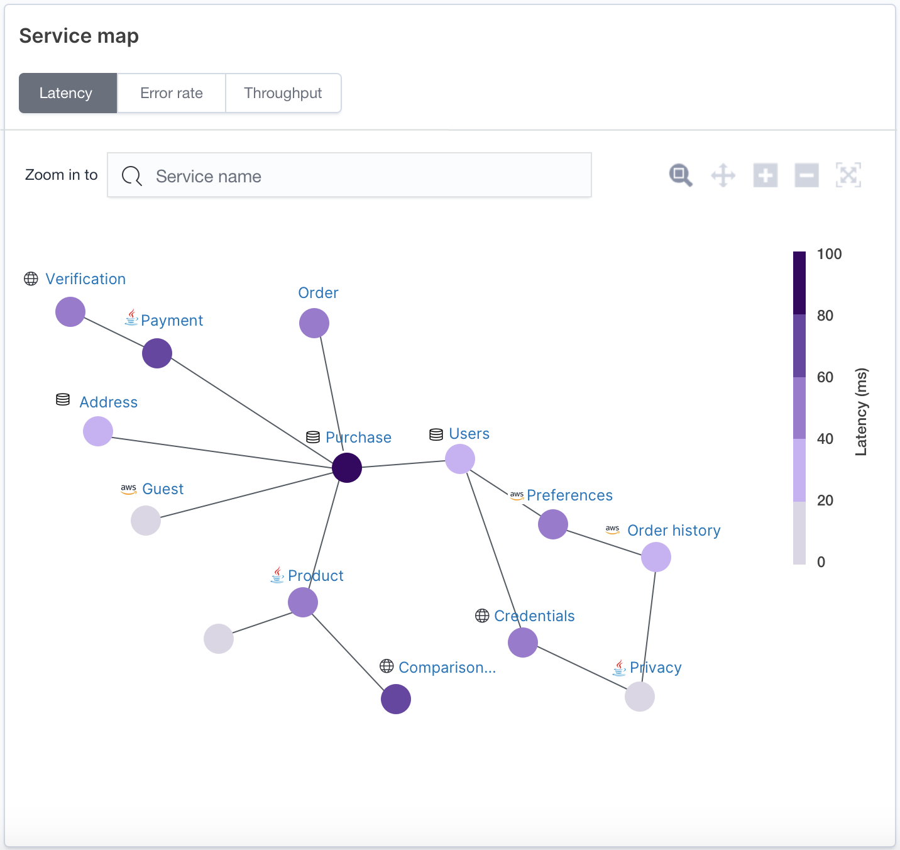
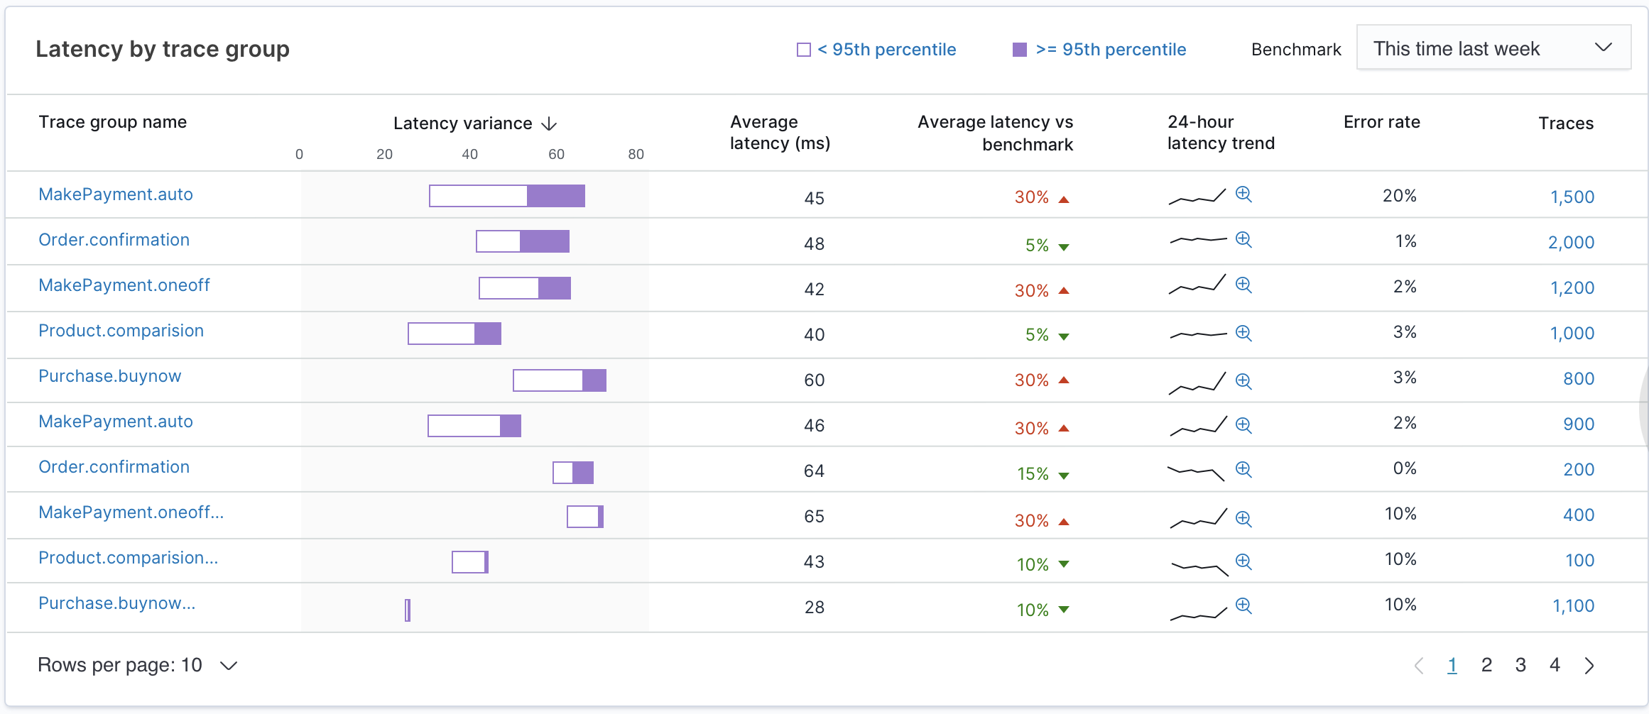
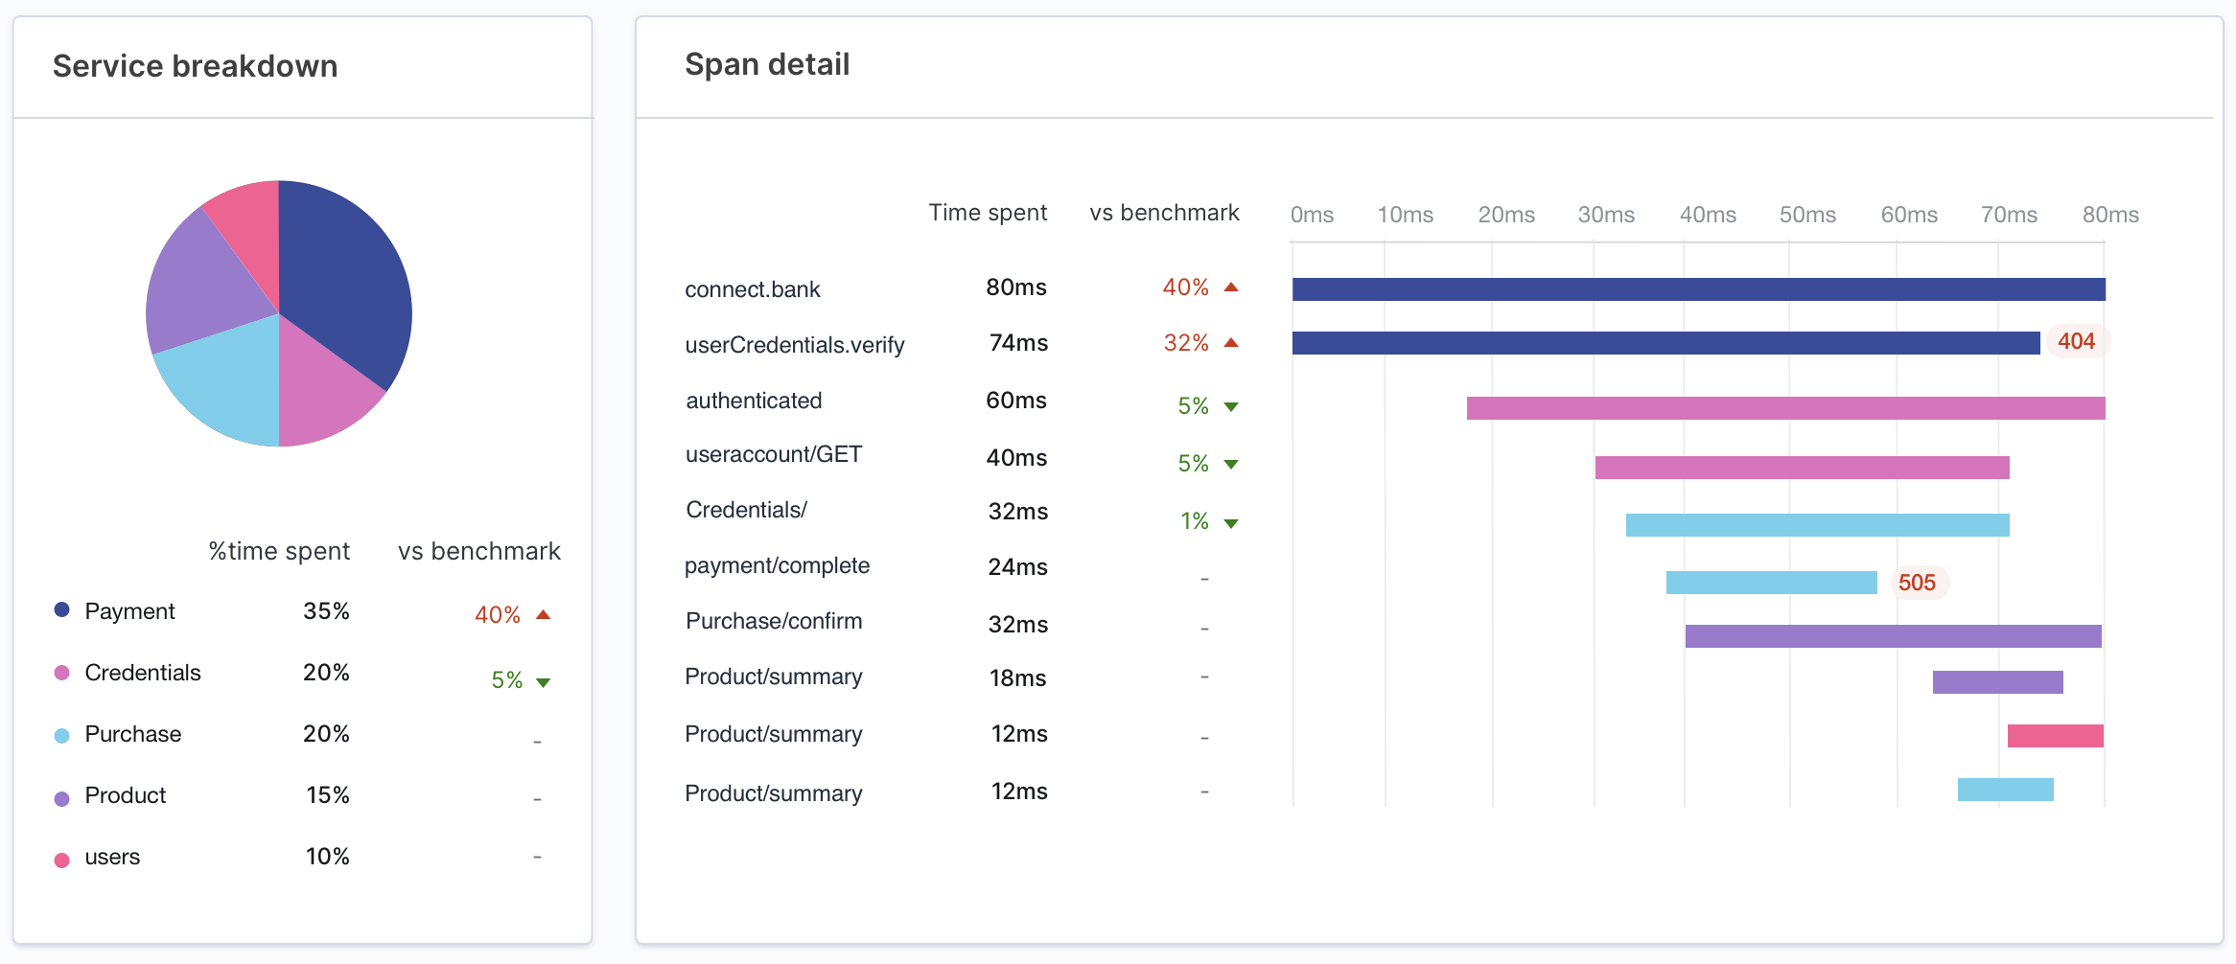
What is Trace Analytics Supports OpenTelemetry (Jaeger, Zipkin, X-Ray SDKs)
Trace-Span Details
Service Maps
Trace Groups
Single request performance
Diagnose root cause
End-to-end view
Isolate issues to services
Monitor performance
Identify issues early
Notes:
Purpose of the slide: Talk about Trace Analytics
1. Developers and IT ops teams use this feature to troubleshoot performance and availability issues in their distributed applications
2. End-to-end insights not possible with traditional methods of collecting logs and metrics from each component and service individually
3. By adding trace data to the existing log analytics capabilities of Amazon OpenSearch Service, customers can use the same service to both isolate the source of performance problems and diagnose their root cause

Slide 38
Cross-cluster search for Amazon OpenSearch Service Increase scalability, efficiency & availability, by separating distinct workloads
Create outbound
connection
Inbound connection
request
Cross-cluster connection from source to destination
Source
Domain
Destination
Domain
Outbound connection
Is active
Accept inbound
Connection request
Search and visualize data across multiple domains from a single OpenSearch Dashboards interface
Increase efficiency— optimize domain resources for specific workloads
Improve availability— isolate failures to specific workloads
Secured through Fine Grained Access Control (FGAC) policies
Notes:
Purpose of the slide: Present the benefits of cross-cluster search
Cross-cluster search enables you to perform searches, aggregations, and visualizations across multiple Amazon OpenSearch Service domains with a single query or from a single OpenSearch Dashboards interface. Previously, if customers needed to query and aggregate data across multiple indices or workloads, they had to provision them into a single domain, a managed cluster of instances, which is inefficient. With cross-cluster search, you can separate heterogeneous workloads into multiple domains, which provides better resource isolation, and the ability to tune each domain for their specific workloads which can improve availability and reduce costs.
Launch announcement:
https://aws.amazon.com/about-aws/whats-new/2020/06/announcing-cross-cluster-search-support-for-amazon-elasticsearch-service-for-aws-govcloud-us/

Slide 39
Machine Learning in Amazon OpenSearch Service
Mitigate issues faster with anomaly detection in streaming data
Improve search quality and relevance with K-Nearest Neighbor (K-NN) and Learning to Rank models
Performant at scale. Machine learning models are distributed and processed across nodes
Easy to use. Machine learning expertise is not required to leverage the service
Notes:
Purpose of the slide: Share how machine learning is applied in Amazon OpenSearch Service and how customers benefit from it
Some of the development of Amazon OpenSearch features, such as anomaly detection, has been a joint collaboration between the Amazon OpenSearch Service and AWS Machine Learning teams. Machine learning-based search features provides personalized search results and improves search quality. You can build a similarity search engine with K-Nearest Neighbor (K-NN), and use Learning to Rank models to improve search relevance.
More details:
https://aws.amazon.com/about-aws/whats-new/2020/06/real-time-anomaly-detection-support-amazon-elasticsearch-service/
https://aws.amazon.com/about-aws/whats-new/2020/03/build-k-nearest-neighbor-similarity-search-engine-with-amazon-elasticsearch-service/
https://docs.aws.amazon.com/elasticsearch-service/latest/developerguide/learning-to-rank.html

Slide 40

AWS Glue Elastic Views (Preview)
Store Amazon DynamoDB data in Amazon OpenSearch Service
Easy to use: Use familiar SQL to create materialized views of data data in multiple different data stores.
Fully managed: Copies data automatically from source data stores to target data stores.
Near real-time: Continuously monitors source data stores for changes and updates target data stores within seconds.
Serverless: Scales capacity up or down to support your workloads. Pay for what you use.
Sign up for preview at https://pages.awscloud.com/AWS-Glue-Elastic-Views-Preview.html
Notes:
Purpose of the slide: Explain AWS Glue Elastic Views
AWS Glue Elastic Views makes it easy to build materialized views to combine and replicate data across multiple data stores without you having to write custom code– it enables you to create materialized views using familiar SQL. AWS Glue Elastic Views currently supports Amazon DynamoDB as a source data store and Amazon Redshift, Amazon S3, and Amazon OpenSearch Service as target data stores. Support for more data stores will follow.
AWS Glue Elastic Views is a fully managed service that automatically processes changed data from source data stores and provides updates to materialized views in target data stores.
AWS Glue Elastic Views monitors for changes to data in your source data stores continuously, and provides updates to your target data stores automatically. This ensures that applications always access up-to-date data in the materialized views.
AWS Glue Elastic Views is serverless and scales capacity up or down automatically to accommodate your workloads. There is no hardware or software to manage, and you pay only for what you use.

Slide 41
Getting started

Slide 42
Resources
New releases What’s New
Documentation Developer Guide
Blogs Moving to managed: The case for the Amazon OpenSearch Service
Best practices for configuring your Amazon OpenSearch Service domain
Amazon OpenSearch Service Immersion Days
Provides a deep dive into Amazon OpenSearch Service through a mix of online trainings and hands-on labs led by AWS Solutions Architects. You will learn all the key concepts to leverage the service along with the operational best practices.
Interested in scheduling Immersion Days?
Contact us
searchservices-ww-gtm@amazon.com
Notes:
Purposes of the slide: Point customers to some of the resources available for further discussions.

Slide 43
Simple to get started…
1
2
3
Create an AWS Free Tier account
Launch an Amazon OpenSearch Service Cluster in minutes
Follow the Getting Started Tutorial to build a log analytics solution
Notes:
Purpose of the slide: Highlight how easy it is to get started with the service and start extracting value from your data.

Slide 44
Thank you!

